Slide 1
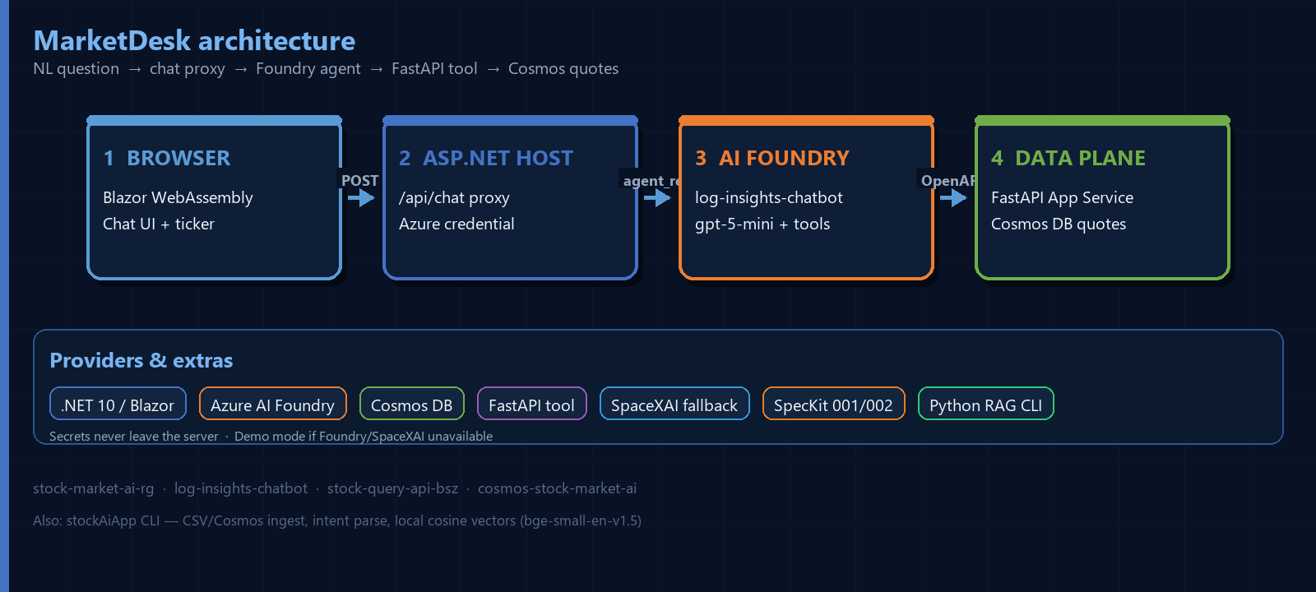
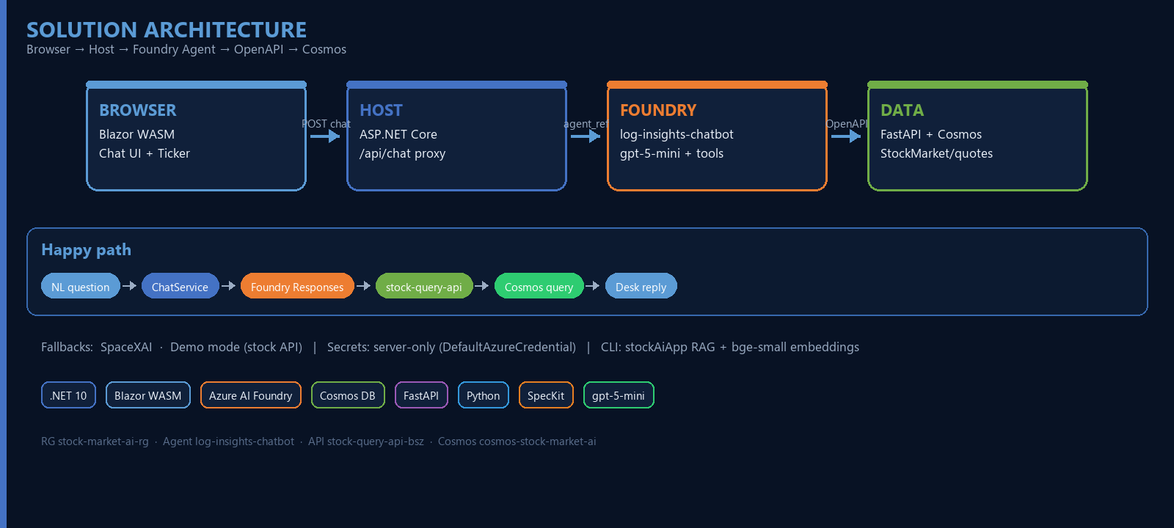
AI UPSKILL · MAY 2026
3-WEEK INITIATIVE
TITLE – STOCK MARKET AI CHATBOT
TEAM
INTRODUCTION
OTHERS
Bela Szimandl
AI / Full-stack
MarketDesk
Foundry + Cosmos
MarketDesk: NL stock quotes & log insights for analysts. Azure AI Foundry + Cosmos power answers; Blazor WASM delivers a trading-desk chat UI—no SQL required.
IMPACT
Live Foundry agent + OpenAPI tools on Cosmos quotes; MarketDesk UI with durable ticker; Python CLI for log RAG; SpecKit 001/002 specs.
SOLUTION
TECH STACK
LEARNINGS
.NET 10
Foundry
Cosmos
Solid OpenAPI tool contracts; Azure credential chain; secrets stay server-side; pace for gpt-5-mini limits; local cosine before native vectors.
Blazor
FastAPI
Python
gpt-5-mini
NEXT STEPS
Native Cosmos vector index; higher model quota; live market APIs; richer insights; auth + observability hardening.
BUSINESS CHALLENGES
Blazor WASM → ASP.NET /api/chat (secrets server-only). Foundry agent log-insights-chatbot (gpt-5-mini) + OpenAPI → FastAPI stock-query-api-bsz → Cosmos StockMarket/quotes. Fallbacks: SpaceXAI / demo. Python stockAiApp: CLI RAG, ingest, local vectors. SpecKit 001/002. Fixed: low RPM via pacing; WASM isolation via proxy + DefaultAzureCredential.
Log & market data overload for analysts
SQL/dashboard skills needed for simple Qs
Secrets must never ship in WASM clients
Need scalable NL query over Cosmos data
ADDITIONAL NOTES
RG stock-market-ai-rg · Agent log-insights-chatbot · API stock-query-api-bsz · Cosmos cosmos-stock-market-ai · stockMarketChat / stockAiApp / stockQueryApi
.NET AI UPSKILL INITIATIVE — MAY 2026
CONFIDENTIAL

